Slide 1

Understanding Customer Feedback with Machine Learning By: Kai Wilson

Slide 2

topic
Analysis of better business bureau (BBB) Company data
What are the most common keywords and key phrases from Carvana’s complaints and keywords.
How has the sentiment changed over time.

Slide 3

What is BBB?
They are a Non-profit organization that provides information about business and charities to help consumers make informed decisions.

Slide 4

Carvana
An online-only used care retailer.
Years in Business: 12
Business Started: 6/22/2015

Slide 5
AND Since they have been around for a while we can review their company data to see their company is perceived online.

Slide 6
But we needed a way to get all the customer information and complaints, then analyze all the information.

Slide 7
Therefore I created a script that would web scrape the information from the bBB site and then used a analyzed the data for Keywords, key phrases and Sentiment

Slide 8
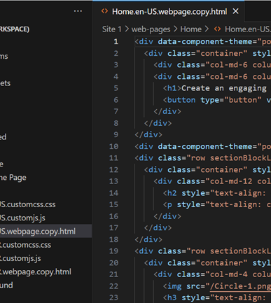
Tools used
Python to gather/clean/analyze the data
Py Shiny Dashboard to visualize the results

Slide 9
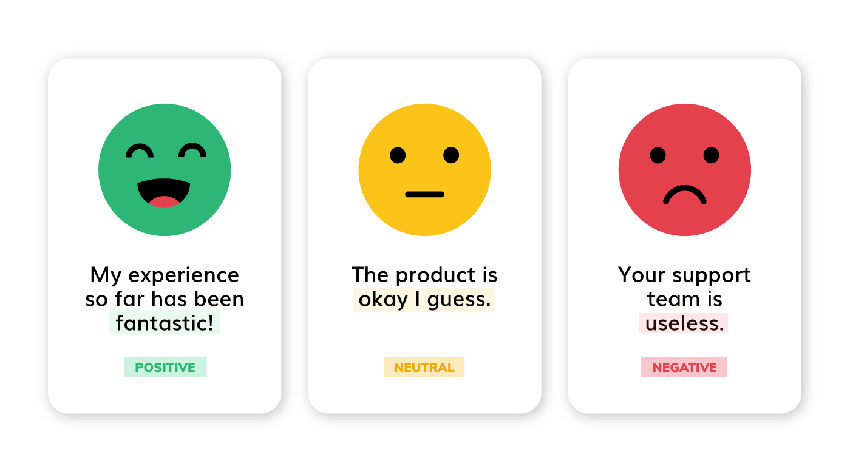
What is Sentiment Analysis
The process of computationally identifying and categorizing opinions expressed in a piece of text, especially to determine whether the writer's attitude towards a particular topic, product, etc. is positive, negative, or neutral.
To train the model I used 42,388 reviews from a yelp JSON file and a few reviews from the BBB site itself
4-5 stars were considered positive sentiment
3 stars were neutral sentiment
1-2 stars were negative sentiment

Slide 10
The Dashboard

Slide 11

The perception of a business didn’t make sense in light of reviewing its customer feedback

Slide 12

THANK YOU
Questions?

